Slide 1
Natural Language Processing and
Speech Recognition

Slide 2
Audio Synthesis and Generation Generative Models for Audio

Slide 3

Understand audio signal processing
Learn about WaveGAN model
Explore applications of GAN

Slide 4
Generative Adversarial Networks

Slide 5
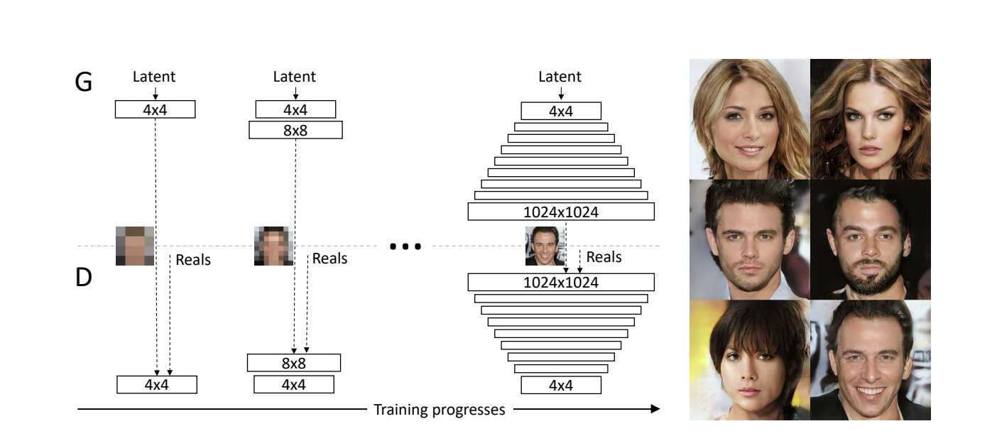
GAN: Introduction
Generative Adversarial Networks (GANs) were state of the art generative models until diffusion-based models were introduced.
GANs have advanced to the point where synthetic images are indistinguishable from real ones, highlighting their remarkable progress.
Interestingly, GANs can now generate more than just images; their applications have expanded to include audio data generation.

Slide 6
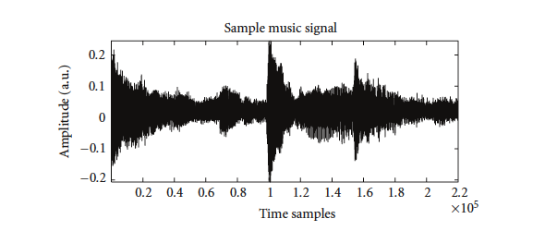
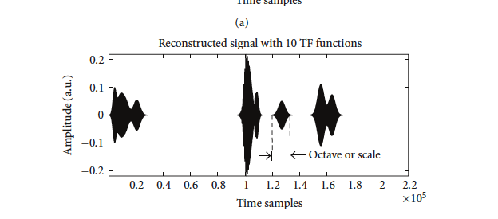
Audio Signals
Audio signals are perceived as varying sounds over time, akin to a time series. This temporal nature is central to how sound data is interpreted and analyzed.
Sample music signal
Reconstructed signal with 10 TF functions
Image source: Audio Signal Processing Using Time-Frequency Approaches:
Coding, Classification, Fingerprinting, andWatermarking, K. Umapathy et.al

Slide 7

Audio Signals
If a moment in time were frozen, the sound heard could be encapsulated by a single numerical value.
This refers to the amplitude concept at a specific time, resulting in the representation of sound as a function:
$$a=f(t)$$
Here,
a is amplitude
t is time

Slide 8

Audio Signals
Naturally, sound waves are continuous. To digitally process them, sampling the sound wave at discrete intervals is essential, a process dictated by the sampling rate.
For instance, a sampling rate of 16,000 Hz signifies that we measure the sound's amplitude 16,000 times per second.
Therefore, a 2-second audio clip is translated into a vector with 32,000 discrete amplitude values, effectively digitizing our audio signal.

Slide 9


Audio Signals vs Image Inputs
Digital representations of images use multi-dimensional arrays or tensors.
Grayscale images employ single matrices, while color images utilize multiple matrices.`
Audio signals are illustrated as one-dimensional vectors.
Each element within the vector represents a snapshot of the sound wave at a particular moment in time.

Slide 10
WaveGAN

Slide 11
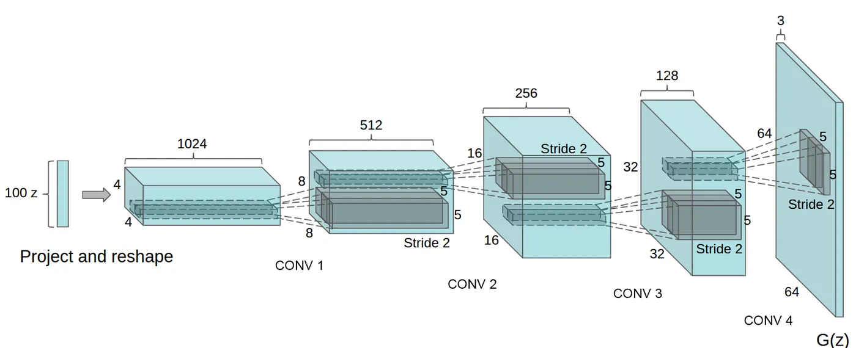
WaveGANs
WaveGAN was first introduced in the paper titled 'WaveGAN: A Generative Model for Raw Audio' by Donahue et al. as a GAN architecture capable of synthesizing audio.
The network closely resembles DCGAN, commonly used for image generation, employing convolutional layers in both the generator and discriminator.
Image source: Review on Generative Adversarial Networks: Focusing on Computer Vision and Its Applications Sung-Wook Park et. Al.

Slide 12
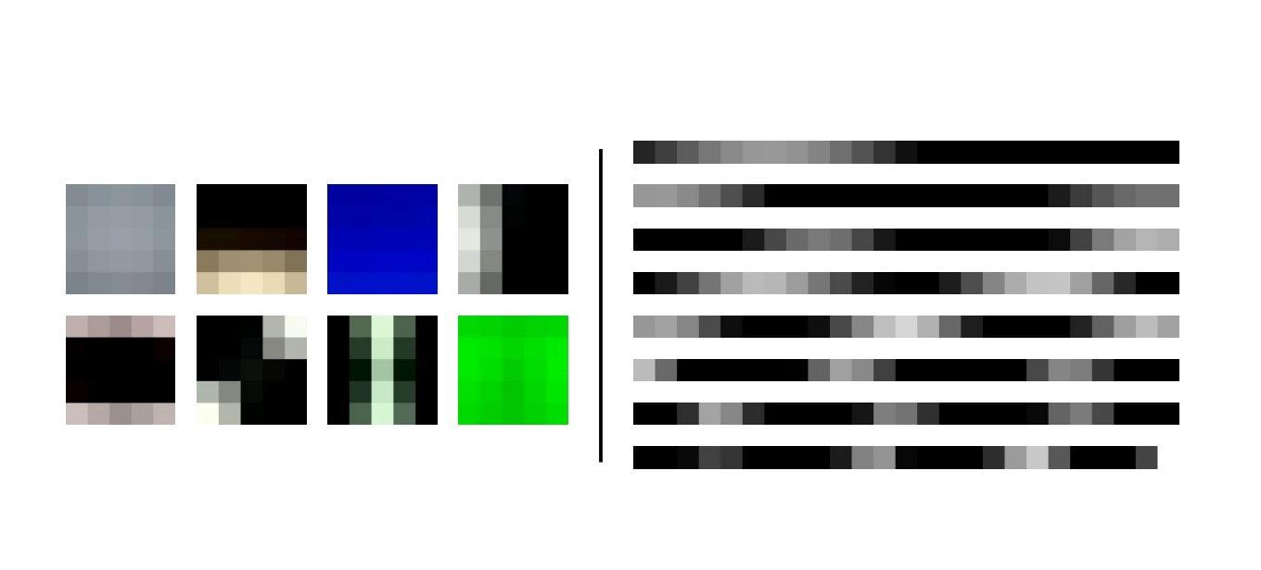
WaveGANs
It is important to note that images are represented as 2D matrix, while audio is in the form of 1D vectors.
Hence the DCGAN architecture was modified to accommodate this change in the data.
Image source: Adversarial audio Donahue et al.

Slide 13
WaveGANs
Since 2D filters cannot be used, 5x5 2D filters in DCGAN now become 25 long 1D filters in WaveGAN.
The image below compares the first eight principal components for 5x5 patches from natural images with those of length-25 audio slices from speech.
Natural images
Audio slices
Periodic patterns are unusual in natural images but a fundamental structure in audio.
Image source: Adversarial audio Donahue et al.

Slide 14
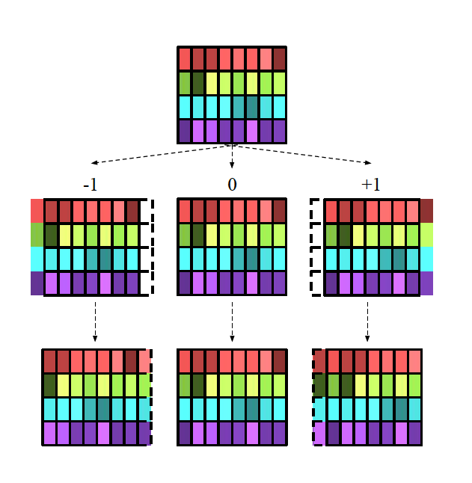
WaveGANs
For upscaling, instead of using transpose convolutions, WaveGAN employs a technique called phase shuffle, which involves using up-sampling layers (nearest neighbors) followed by normal convolutions.
In every WaveGAN discriminator layer, the phase shuffle operation alters the phase of each feature map by a random shift within the range of [-n; n] samples.
It fills in the missing samples (shown as dashed outlines) through reflection.
Image source: Adversarial audio Donahue et al.

Slide 15
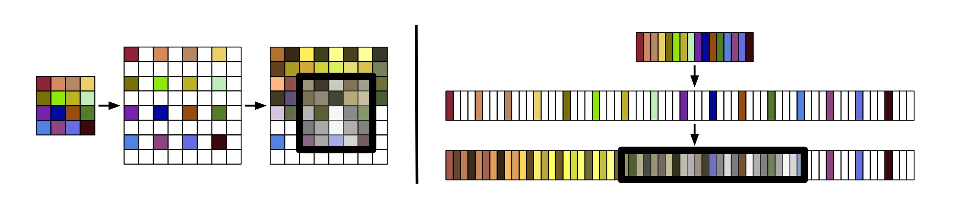
WaveGANs
WaveGAN uses a longer 1D filter and a larger upsampling factor compared to DCGAN, while maintaining the same number of parameters and numerical operations.
The figure below shows the depiction of the transposed convolution operation for the first layers of the DCGAN and WaveGAN
DCGAN
WaveGAN
Image source: Adversarial audio Donahue et al.

Slide 16
Applications of WaveGAN

Slide 17




Application of WaveGAN
WaveGAN, as a generative model for raw audio waveforms, has various applications in the field of audio synthesis, signal processing, and related domains. Some notable applications include:
Sound effect generation
Speech synthesis
Music creation

Slide 18
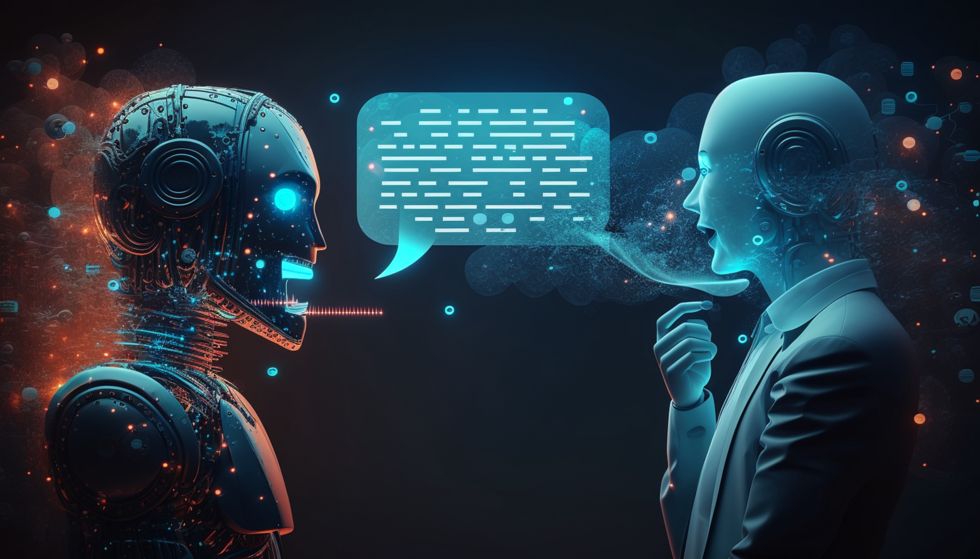
Application of WaveGAN
Speech synthesis
Regular speech synthesis uses text-to-speech systems converting written text to spoken words.
WaveGAN, however, can be trained on human speech to create fresh speech samples.

Slide 19
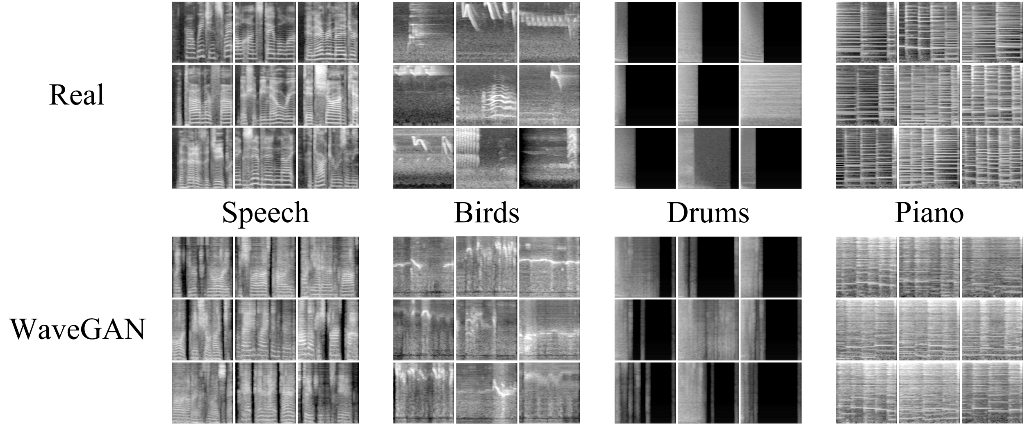
Application of WaveGAN
Sound effect generation
WaveGAN can produce a variety of sounds, from environmental noises like rain or wind to mechanical sounds like engine hums or beeps.
It does not even need to record the actual objects, thus saving time and resources.
This can be highly beneficial in the gaming industry and film production.

Slide 20
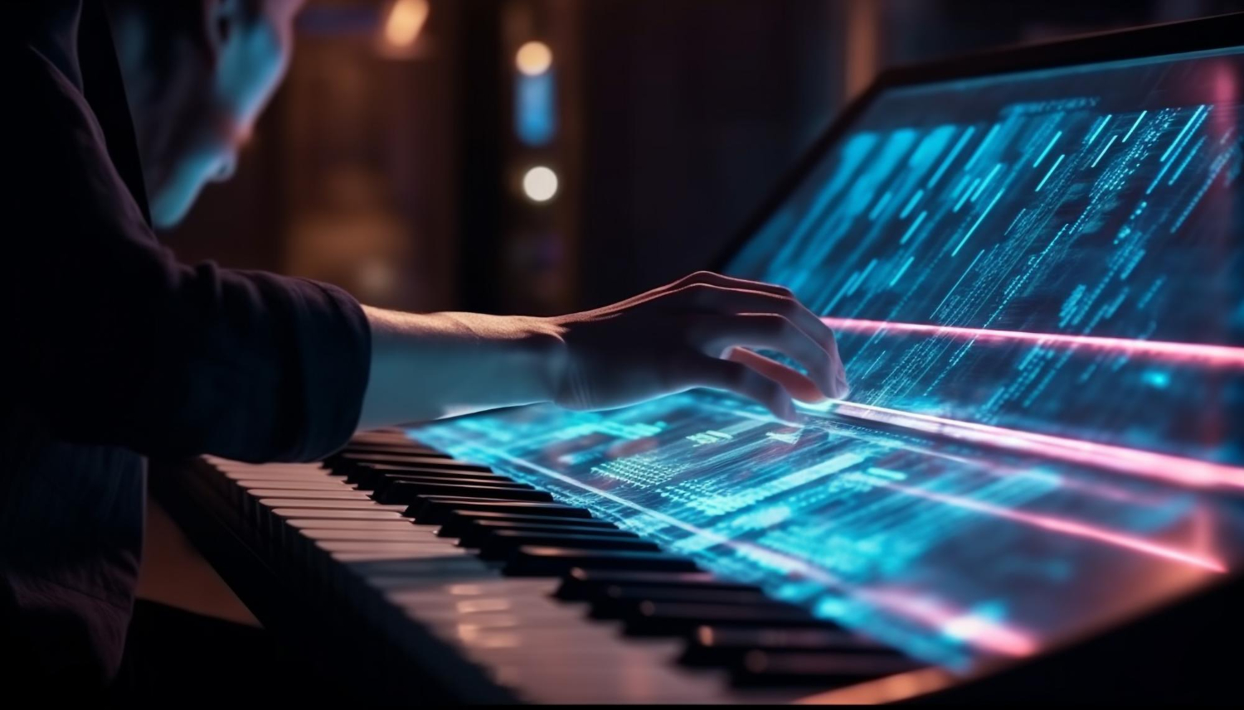
Application of WaveGAN
Music generation
One of the most exciting applications of WaveGAN is in the field of music.
WaveGAN can produce music or imitate instrument sounds without playing real instruments.

Slide 21
Audio signals are perceived as varying sounds over time, akin to a time series.
To digitally process them, sampling the sound wave at discrete intervals is essential, a process dictated by the sampling rate.
WaveGAN has various applications in the field of audio synthesis, signal processing, and related domains.

Slide 23
How are audio signals typically perceived?
1
As static noises
Constant pitches
Varying sounds over time
Steady frequencies

Slide 24
How are audio signals typically perceived?
1
As static noises
Constant pitches
Varying sounds over time
Steady frequencies
C
Audio signals are perceived as varying sounds over time, akin to a time series. This temporal nature is central to how sound data is interpreted and analyzed.

Slide 25
What technique does WaveGAN employ for upscaling?
2
Transpose convolutions
Phase shuffle
Nearest neighbors
Normal convolutions

Slide 26
What technique does WaveGAN employ for upscaling?
2
Transpose convolutions
Phase shuffle
Nearest neighbors
Normal convolutions
B
WaveGan uses the phase shuffle technique, which involves using up-sampling layers (nearest neighbors) followed by normal convolutions.

Slide 27
How does WaveGAN handle the generation of different sound variations such as rain, wind, or engine sounds?
3
It records actual environmental sounds.
It combines various recorded sounds.
It uses complex mathematical equations.
It generates these sounds based on trained data patterns.

Slide 28
How does WaveGAN handle the generation of different sound variations, such as rain, wind, or engine sounds?
3
It records actual environmental sounds.
It combines various recorded sounds.
It uses complex mathematical equations.
It generates these sounds based on trained data patterns.
D
WaveGAN generates different sound variations based on trained data patterns.

Slide 29
Thank You!

